Slide 1
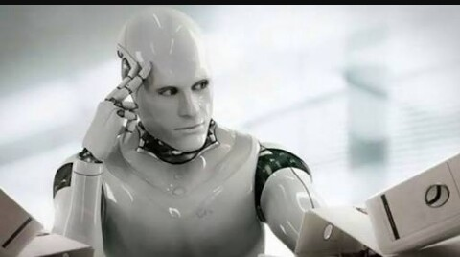
Machine Consciousness

Slide 2

Contents:
Introduction.
Levels of Machine Consciousness.
Reactive, Deliberative and Reflective
mechanisms of information processing.
Perspectives of machine consciousness.
Problems in implementation.
Evolution of AI life.
Areas of Machine consciousness.
Relationship between Machine consciousness and
other areas.
Criticisms of Machine consciousness.
Research on Machine Consciousness.

Slide 3
Contents(Contd..)
Issues of Machine Consciousness.
Benefits of Machine Consciousness.
Conscious System Requirements.
Computational Model of Machine Consciousness.
Conclusion.
Future Scope.
References.

Slide 4
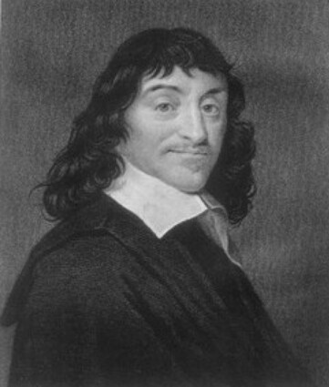
Descartes declared that matter is non-thinking and extends
in space, but mind is a “thinking thing” that’s
“non-extended.” These metaphysical God-given “rational
souls” were ghosts controlling our body’s machinery
(whereas animals were soulless machines).

Slide 5

Big Questions
What is consciousness?
What is Machine consciousness?
Why artificial machine consciousness?
Can a machine think?
How to build conscious machine?
Is simulation of consciousness the same as consciousness?
Should we build intelligent machines?
Notes:
2017/4/8
5

Slide 6
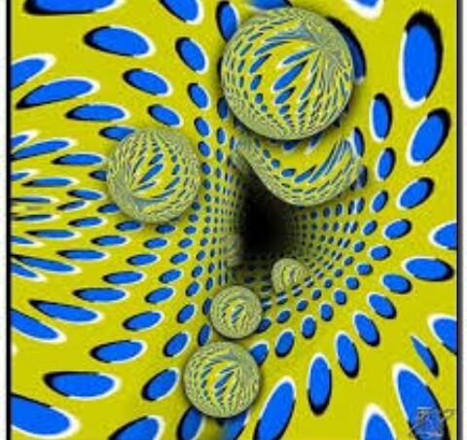
LET’S TRY TO EXPLORE ANSWERS TO THESE QUESTIONS,,,,,

Slide 7
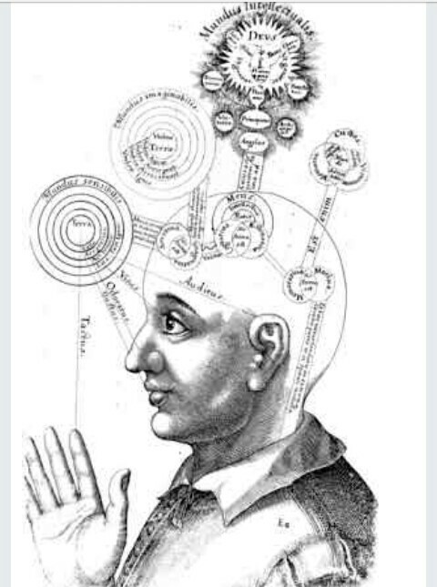
What’s consciousness?
Quality or state of being aware of an external object.

Slide 8
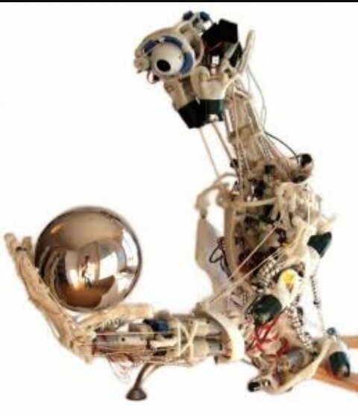
What’s Machine Consciousness?
Machine consciousness refers to attempts to design and analyze informational machines.
Notes:
2017/4/8
8

Slide 9
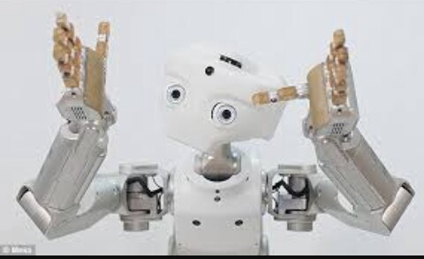
Why artificial machine consciousness?
Design machines resembling human beings.
Interpret the nature of consciousness .
Implementing more efficient control systems.

Slide 10

Can a machine think?
Till date, it’s not known whether machines (computers) can think or not , nor if humans are machines. Henceforth,,,, the effort to build conscious machines will probably give us the answer.

Slide 11
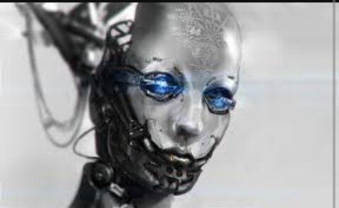
Should we build intelligent machines?
Required in applications which requires reasoning, problem solving ,,,,,
In Autonomous vehicles .*
Medical diagnosis.
Creating art.
Proving mathematical theorems.
Playing games .**
Search engines .***
Online assistants .****
Image recognition in photographs.
Notes:
*drone sand and self driving cars
**chess ,go
***google
****siri

Slide 12
Should we build intelligent machines?(contd..)
Spam filtering.
Prediction of judicial decisions .
Targeting online advertisements.

Slide 13


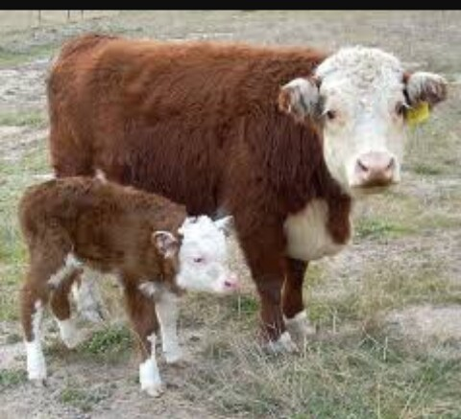
LEVELS OF MACHINE consciousness

Slide 14
LEVELS OF MACHINE consciousness
Sloman and Chrisley suggest that instead of defining and characterizing consciousness, it is better to put down the expected traits of something being conscious*
Besides avoiding unnecessary abstraction and unproductive philosophical rigor, it serves another important purpose. It provides a guideline for artificially implementable aspect of consciousness and a manner of defining the requirements for a machine to be conscious. **
The point that is being made is that multiple levels of abstractions may be defined regarding the expected level and form of consciousness
Notes:
*(a fly being conscious, a new-born calf being conscious, a file protection system being conscious, etc.).
**For instance, for a fly (robot-fly) to be conscious, it needs to be able to identify an impending swat as a threat (something to avoid), the direction of threat, and a possible escape. Its consciousness need not require it to be aware of this action, or to feel happy about escaping the threat. Similarly, a new born calf needs to be aware of mother’s presence, and that she can feed him, that he should suckle the mother, and that he needs to reach the mother in order to feed himself. He need not know the exact form of hunger, or what mother exactly is, or that there is a need to traverse the space between him and the mother, and so on. Another example is the requirement of consciousness in a file protection system.

Slide 15
LEVELS OF MACHINE consciousness(CONCLUSION)
Consciousness is an emerging phenomenon. It involves perception, learning, memory, decision making, and self-awareness. Like intelligence, consciousness may be more or less developed. For instance, social consciousness is less developed in an average 10 years old child than in an adult. The child’s frontal area responsible for empathy, responsibility, etc. is still developing. So, we would like to define a scalable concept of consciousness by describing a minimum set of conditions for a conscious mind.

Slide 16
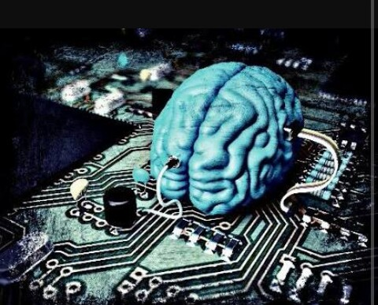
REACTIVE,DELIBERATIVE AND REFLECTIVE MECHANISMS OF INFORMATION PROCESSING
Reactive mechanism means that the virtual machine always lives in present (never in past or future) and simply reacts or responds to the present stimuli. It is able to make sense of the presently acquired information and choose an action from presently possible options. It never learns from past, nor can it predict future possibilities, and thus it cannot plan, predict, foresee and adapt.

Slide 17
REACTIVE,DELIBERATIVE AND REFLECTIVE MECHANISMS OF INFORMATION PROCESSING
Deliberative mechanism, on the other hand, is equipped with an advanced ontology that can represent, store, process and relate to the possibilities (of input information, intermediary and internal states, as well as the possible actions). Thus, in some sense (depending upon the richness, depth and breadth, and design of ontology), it has the ability to learn, plan and govern its actions while being aware of the process and having active involvement in it.

Slide 18
REACTIVE,DELIBERATIVE AND REFLECTIVE MECHANISMS OF INFORMATION PROCESSING
Reflective mechanism enables the virtual machine to reflect on its own actions, to self-monitor, self-examine, and self control. Self-control in reflective mechanism is a result of being aware of one-self and one’s own actions. Thus, it is reflective mechanism that shall enable the machine to possess qualia, introspect itself, possess emotions, and relate to itself and its own existence. It also enables a machine to interpolate its self-knowledge in order to understand other machines.

Slide 19

PERSPECTIVES OF MACHINE CONSCIOUSNESS:
According to Sloman ,,,consciousness is the catalyst of action (consciousness initiates action, or appropriate.

Slide 20
verification of PERSPECTIVES OF MACHINE CONSCIOUSNESS:
Plants indicate that they too are virtual machines . Example : Pitcher Plants and touch-sensitive mimosa pudica.
Plants can’t be referred as conscious because Contemporary AI machines that exhibit some kind of information processing and control should also be referred to as being conscious which, obviously is an overstatement.
The actions performed by low level animals (like insects) are basically sensory motor skills or results of circadian (sleep/wake) rhythm, and do not require consciousness. but these animals are not conscious.

Slide 21

PERSPECTIVES OF MACHINE CONSCIOUSNESS:
According to Muller ,,,Consciousness needs to involve a centralized system (unlike plants) .He says that it is someone (I, he, it), a center of being, that is aware or conscious and that experiences.

Slide 22
verification of PERSPECTIVES OF MACHINE CONSCIOUSNESS:
We can partially agree that centralized system is necessary for consciousness. More evolved and conscious animals invariably have a developed central nervous system. It is also notable that the level of consciousness increases with the development of pre-frontal cortex. Henceforth ,, centralized system is necessary but not sufficient for consciousness and other conditions must be present as well .

Slide 23
PERSPECTIVES OF MACHINE CONSCIOUSNESS:
Different perspective is presented by Blackmore and Velmans. They propose that human-like consciousness is an illusion (it exists but is not what it appears to be). When we try to replicate human/animal behaviour, we create this illusion that we are a conscious self having a stream of experiences.

Slide 24
verification of PERSPECTIVES OF MACHINE CONSCIOUSNESS:
Consciousness is not an illusion; it does exist and is experienced physically.

Slide 25
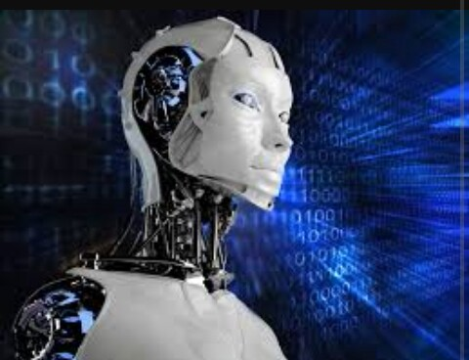
Problems in implementation
The problem of formalism and abstraction.*
Various important
questions arise:
Should, to what extent,
and which physical
phenomena affect the
consciousness?
b) How these physical phenomena
should be represented?
c) How should they affect the consciousness? In what form should the consciousness be implemented and how can it manifest itself.**
Notes:
*Consciousness is built upon,
concerns , and affects,
the physical phenomena
occurring in and
around the virtual machines.
**(actions, alarms, emotions, adaptations, etc.)?

Slide 26
Problems in implementation(CONTD..)
Knowledge of possibilities is usually limited, and may not suffice for implementing the desired effect.
Availability, adequacy and viability of the technology for implementation of consciousness.

Slide 27
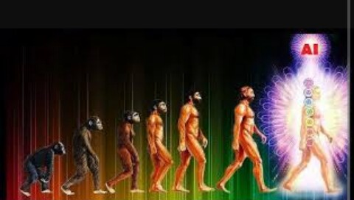
Evolution of AI life
Computational AI Life *can be divided into three categories: 1) situated-agent systems, 2) self-replicating evolving program systems, and 3) artificial chemistries .
Notes:
*as opposed to wet A Life or synthetic biology)

Slide 28
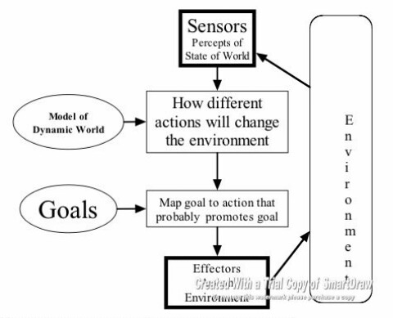
Evolution of AI life(contd..)
1) Situated-agent systems:
Agents *are evolved in a physical environment or semi-physical simulation. The agents are evolved using various forms of population-based evolutionary algorithms.**
Notes:
*(either simulated or real)
**These fitness functions often measure aspects of specific task completion such as distance traveled, objects located, or acquisition of simulated energy, food or materials .
3*The agents are self-contained code sections residing in core memory, and don’t necessarily represent anything beyond their own pattern in the machine

Slide 29

Evolution of AI life(contd..)
2) Self-replicating evolving program systems:
Include platforms such as Tierra *Define populations of code snippets that are placed in memory in a specialized virtual machine and are run in parallel**
Notes:
1*(Ray 1991) and Avida (Adami and Brown 1994).
2*, governed by a dedicated operating system associated with the virtual machine
. In this sense, self-replicating programs might be considered to be not just simulations, but real instances of evolving systems (Ray 1991).
The agents are self-contained code sections residing in core memory, and don’t necessarily represent anything beyond their own pattern in the machine.
State-of-the-art self-replicating program systems support populations of tens of thousands of individuals and can propagate these at rates on the order of an effective generation per second (Shao and

Slide 30

Evolution of AI life(contd..)
3) Artificial chemistries:
A Chem systems have also received much attention in the last decade and are used extensively as theoretical tools.

Slide 31

Areas of Machine Consciousness Research

Slide 32
Areas of Machine Consciousness Research Contd.
1)Machines with the External Behaviour Associated with Consciousness (MC1):
A lot of our waking behaviours are carried out unconsciously in response to stimulation from behaviour include patients in a persistent vegetative state, who commonly produce the environment. *
Notes:
*For example, the detailed muscle contractions involved in walking are rarely under conscious control and we can perform relatively complex behaviours, such as driving home from work, with our attention on other things.

Slide 33
Areas of Machine Consciousness Research Contd.
2)Machines with the Cognitive Characteristics Associated with Consciousness (MC2):
A number of connections have been made between consciousness and cognitive characteristics, such as imagination, emotions and a self. For example, Metzinger (2003) puts forward eleven constraints on conscious experience and Aleksander (2005) suggests five cognitive mechanisms that are minimally necessary for consciousness . Detailed descriptions of conscious states have also been put forward by phenomenologists,

Slide 34
Areas of Machine Consciousness Research Contd.
3)Machines with an Architecture that is Claimed to be a Cause or Correlate of Human Consciousness (MC3):
Many people are working on the simulation of architectures that have been linked to human consciousness, such as Baars’ (1988) global workspace, neural synchronization (Crick, 1994) or systems with high information integration (Tononi, 2004). This type of research often arises from the desire to model and test neural or cognitive theories of consciousness and it is one of the most characteristic areas of machine consciousness.

Slide 35
Areas of Machine Consciousness Research Contd.
4)Phenomenally Conscious Machines (MC4):
The first three approaches to machine consciousness are all relatively uncontroversial, since they are modelling phenomena linked to consciousness without any claims about real phenomenal states. The fourth area of machine consciousness is more philosophically problematic, since it is concerned with machines that have real phenomenal experiences machines that are not just tools in consciousness research, but actually conscious themselves.

Slide 36
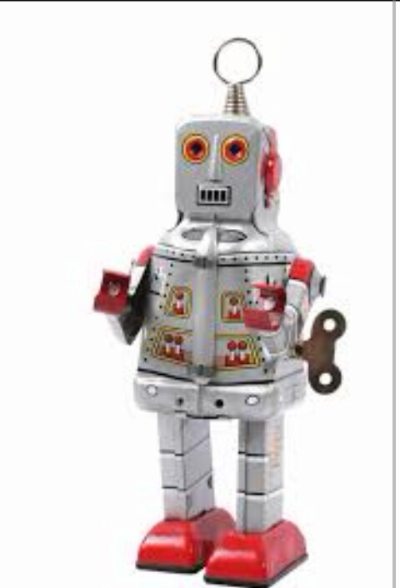
Relationship between Machine consciousness and other Areas.
1)Strong and Weak AI :
a)Weak AI:
Notes:
a contrast is set up between the external manifestations of a mind and a real mind, which suggests a reasonably clear mapping between MC4 and strong AI,with MC1-3 being examples of weak AI in Searle’s sense.The problem with strict identity between MC4 and strong AI is that the notion of mind can be separated from phenomenal consciousness suggesting that computers can really be minds without being conscious in the sense of MC4.

Slide 37
Relationship between Machine consciousness and other Areas.
According to weak AI, the principal value of the computer in the study of the mind is that it gives us a very powerful tool. For example, it enables us to formulate and test hypotheses in a more rigorous and precise fashion.

Slide 38

Relationship between Machine consciousness and other Areas(contd..)
b)Strong AI :

Slide 39
Relationship between Machine consciousness and other Areas(contd..)
According to strong AI, the computer is not merely a tool in the study of the mind: rather, the appropriately programmed computer really is a mind, in the sense that computers given the right programs can be literally said to understand and have other cognitive states.

Slide 40

Relationship between Machine consciousness and other Areas.(contd..)
2)Artificial General Intelligence:

Slide 41
Relationship between Machine consciousness and other Areas.(contd..)
Has similarities with machine consciousness. AGI systems may be produced by copying the cognitive states associated with consciousness (MC2) .
AGI systems may have phenomenal states (MC4).

Slide 42

Relationship between Machine consciousness and other Areas.(contd..)
3) Psychology, Neuroscience and Philosophy:
Notes:
*MC2.However, this work is more general than that carried out by machine consciousness because it covers types of cognition that are not associated with conscious states1*The emergence of machine consciousness has changed this relationship and philosophy now provides a
theoretical framework for MC1-4 and tackles ethical issues.

Slide 43
Relationship between Machine consciousness and other Areas.(contd..)
Cognitive psychology and connectionism also build computer models of cognition, which leads to a substantial amount of overlap with MC2.*
Although philosophy and AI have historically been linked through their common use of logic, this connection has declined in recent years with the atrophy of logic in both subject areas.*1

Slide 44

Criticisms of Machine consciousness:

Slide 45
Criticisms of Machine consciousness:
1)The Hard Problem of Consciousness:
Chalmers (1996) distinguishes between the easy problem of explaining how we can discriminate, integrate information, report mental states, focus attention, etc., and the hard problem of explaining phenomenal experience. Although solving the ‘easy’ problem is far from easy, we do at least have some idea how it can be done and MC1, MC2 and MC3 are all focused on this issue.

Slide 46
Criticisms of Machine consciousness:
On the other hand, although many theories have been put forward about the hard problem, it can be argued that we have no real idea about how to solve it, and if we don’t understand how human consciousness is produced, then it makes little sense to attempt to make a robot phenomenally conscious (MC4).

Slide 47
Criticisms of Machine consciousness:
2 )The Chinese Room:
The Chinese Room thought experiment consists of a person in a room who receives Chinese characters, processes them according to a set of rules and passes the result back out without understanding what the characters mean. This processing of characters could be used to create have intentional states directed towards the objects represented by the Chinese characters. Although the Chinese Room might be able to model a mind successfully, it will never literally be a mind in the sense intended by MC4.

Slide 48
Criticisms of Machine consciousness(contd..)
the external behaviour associated with consciousness, to simulate the cognitive characteristics of consciousness or to model a conscious architecture. However, Searle (1980) argues that in no case would the person processing characters in the room understand what is going on or have intentional states directed towards the objects represented by the Chinese characters. Although the Chinese Room might be able to model a mind successfully, it will never literally be a mind in the sense intended by MC4.

Slide 49
Criticisms of Machine consciousness(contd..)
3) Consciousness is Non-algorithmic:
Machine consciousness has also been criticised by Penrose (1990, 1995), who claims that the processing of an algorithm is not enough to evoke phenomenal awareness because subtle and largely unknown physical principles are needed to perform the non-computational actions that lie at the root of consciousness.

Slide 50
Criticisms of Machine consciousness(contd..)
If consciousness does something that ‘mere’ computation cannot, then MC1-3 cannot be simulated by a computer and MC4 cannot be
created in a computer.

Slide 51
Criticisms of Machine consciousness(contd..)
4) What Computers Still Can’t Do:
Dreyfus (1992) put forward a number of arguments against artificial intelligence projects that attempted to reduce human intelligence to a large number of rules.11 According to Dreyfus,this can never work because human intelligence depends on skills, a body, emotions,imagination and other attributes that cannot be encoded into long lists of facts.

Slide 52

Research on Machine Consciousness:

Slide 53
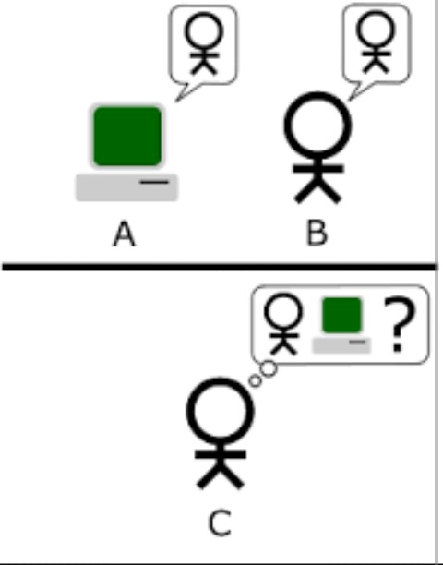
Research on Machine Consciousness:
1)Turing test machine:

Slide 54
Research on Machine Consciousness(CONTD..)
The "standard interpretation" of the Turing Test, in which player C, the interrogator, is given the task of trying to determine which player – A or B – is a computer and which is a human. The interrogator is limited to using the responses to written questions to make the determination.*
Notes:
*A test of a machine's ability to exhibit intelligent behavior equivalent to that of a human.The Turing test is a test, developed by Alan Turing in 1950, of a machine's ability to exhibit intelligent behaviour equivalent to, or indistinguishable from, that of a human. Turing proposed that a human evaluator would judge natural language conversations between a human and a machine that is designed to generate human-like responses. The evaluator would be aware that one of the two partners in conversation is a machine, and all participants would be separated from one another. The conversation would be limited to a text-only channel such as a computer keyboard and screen so that the result would not be dependent on the machine's ability to render words as speech. If the evaluator cannot reliably tell the machine from the human (Turing originally suggested that the machine would convince a human 70% of the time after five minutes of conversation[3]), the machine is said to have passed the test. The test does not check the ability to give correct answers to questions, only how closely answers resemble those a human would give.

Slide 55
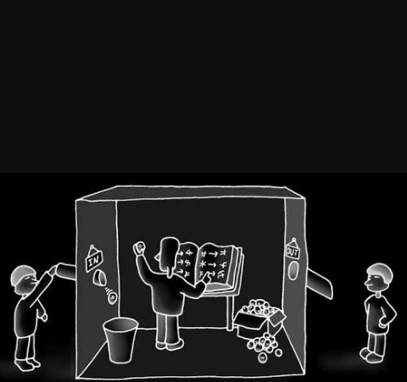
Research on Machine Consciousness(CONTD..)
2)Chinese room:

Slide 56
Research on Machine Consciousness(CONTD..)
In this thought experiment, a person in the "Chinese room" is passed questions from outside the room, and consults a library of books to formulate an answer.
The Chinese room argument holds that a program cannot give a computer a "mind", "understanding “or“ consciousness", regardless of how intelligently or human-like the program may make the computer behave.
Notes:
The argument was first presented by philosopher John Searle in his paper, "Minds, Brains, and Programs", published in Behavioural and Brain Sciences in 1980. It has been widely discussed in the years since. The centre piece of the argument is athought experiment known as the Chinese room.

Slide 57

Research on Machine Consciousness(CONTD..)
3)Hanover:

Slide 58
Research on Machine Consciousness(CONTD..)
3)Hanover:
Microsoft is working on a project to develop a machine called "Hanover". Its goal is to memorize all the papers necessary to cancer and help predict which combinations of drugs will be most effective for each patient. One project that is being worked on at the moment is fighting myeloid luekemia, a fatal cancer where the treatment has not improved in decades. Another study was reported to have found that artificial intelligence was as good as trained doctors in identifying skin cancers.

Slide 59
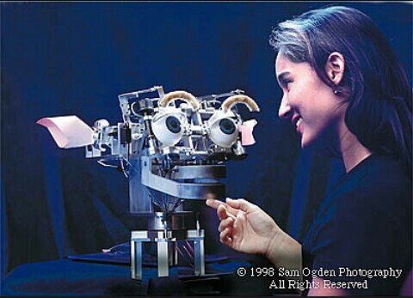
Research on Machine Consciousness(CONTD..)
4)CRONOS:

Slide 60
Research on Machine Consciousness(CONTD..)
It consists of CRONOS, a hardware robot closely based on the human musculoskeletal system SIMNOS, a soft real time physics-based simulation of this robot in its environment, a biologically inspired visual system, this used to be called Magnus.

Slide 61
Research on Machine Consciousness(CONTD..)
5)Cog:
This robot also had a simple emotional system to guide learning and a number of hard wired ‘innate’ reflexes, which formed a starting point for the acquisition of more complex behaviours. The processors controlling Cog were organised into a control hierarchy, ranging from small microcontrollers for joint-level control to digital signal processor networks for audio and visual processing.

Slide 62
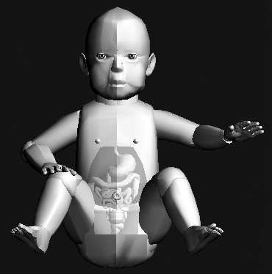
Research on Machine Consciousness(CONTD..)
6)Cyber Child:

Slide 63
Research on Machine Consciousness(CONTD..)
Cyber Child is a simulated infant controlled by a biologically-inspired neural system .This virtual infant has rudimentary muscles controlling the voice and limbs, a stomach, a bladder, pain receptors, touch receptors,sound receptors and muscle spindles. It also has a blood glucose measurement, which is depleted by energy expenditure and increased by consuming milk. As the consumed milk is metabolised, it is converted into simulated

Slide 64
Research on Machine Consciousness(CONTD..)
urine, which accumulates in the infant’s bladder and increases its discomfort level. The simulated infant is deemed to have died when its blood glucose level reaches zero.
Cyber Child also has drives that direct it towards acquiring sustenance and avoiding discomfort and it is able to raise a feeding bottle to its mouth and control urination by tensing its bladder muscle.
However, these mechanisms are not enough on their own to ensure the survival of the simulated infant, which ultimately depends

Slide 65
Research on Machine Consciousness(CONTD..)
on its ability to communicate its state to a human operator.
Cyber Child is controlled by a simulated neural network containing a number of different areas based on the brain’s neuro anatomy, including the pre motor cortex, supplementary motor cortex, frontal eye fields, thalamic nuclei, hippocampus and amygdala.

Slide 66
Research on Machine Consciousness(CONTD..)
7)EMG Data analysis for multilingual speech processing:
EMG data analysis for speech processing aims to recognize speech by analyzing sEMG signals generated by specific muscles in the vocal-chord region. This technology has first been proposed and developed by Jorgensen and Betts and has been named silent voice recognition by adapting it for use in a system that recognizes multiple languages randomly, and have thus renamed the technology to silent speech recognition.

Slide 67
Research on Machine Consciousness(CONTD..)
The main goals of this technology are communication in harsh environments, medical applications and the processing sub-vocal speech. The architecture of a silent speech recognition system is very simple and consists of three main blocks: data acquisition, data processing and training/recognition.

Slide 68

Issues of Machine Consciousness
Notes:
*Work in this area focuses on developing computational models of various aspects of the conscious mind, either with soft- ware on computers or in physical robotic devices.

Slide 69
Issues of Machine Consciousness (contd..)
Over the last two decades there have been increasing efforts to shed light on these questions in the field that is becoming known as artificial consciousness, or synonymously, machine consciousness. * Such efforts face substantial barriers, not the least of which is that there is no generally agreed-upon definition.
When traditional software fails, responsibility is usually allocated to the people who developed it.**
Notes:
*, but the case is much less clear with autonomous systems that learn from their environment
**A conscious machine might malfunction because it has been maltreated, and not because it was badly designed, and so its behaviour could be blamed on its carers or owners, rather than on its manufacturers.

Slide 70

Benefits of Machine Consciousness.

Slide 71
Benefits of Machine Consciousness.
Help us to produce more plausible imitations of human behaviour*
This will eventually lead to machines that can understand our human world and language in a human-like way, which will vastly increase their ability to assist us and interact with us open up inter subjective possibilities between humans and machines, enabling computers to imagine what people might be thinking, empathise with them and imitate them.
Notes:
*In the shorter term, this may appear as more sophisticated chatter bots that carry out simple conversations as part of a telephone or web application development of machines that can connect emotions with objects and situations, attend to different aspects of their environment, and imagine themselves in non-present scenarios.

Slide 72
Conscious System Requirements:
Conscious system is aware of past and present and is capable of critical analysis.
is aware of the environment in which it resides.
has a perception of its internal states.
is capable to predict and explain current and past events.
is capable of autonomous construction of future actions.
can utilize past actions in the formulation of future plans.

Slide 73
Conscious System Requirements:
is able to locate itself in its relationship to other entities.
can generate an internal representation of itself and its environment.
is capable of autonomously and selectively directing its attention to address current important situations.

Slide 74
Theory on Computational Model of Machine Consciousness.
1)Baar’s and Franklin proposed a model of consciousness called the global workspace theory and developed an agent called Intelligent Distribution Agent (IDA).*
According to them -“Consciousness is accomplished by a distributed society of specialists that is equipped with working memory, called a global workspace, whose contents can be broadcast to the system as a whole”. Global workspace theory suggests a fleeting memory capacity in which only one consistent content can be dominant at any given moment”.
Notes:
*IDA is an agent that was designed for the U.S.
navy for the purpose of collecting information from
personnel, assessing the personnel on the basis of their
performance and the issues they have had as human beings,
and help in new task-allocation and problem identification.

Slide 75
theory on Computational Model of Machine Consciousness(contd..)
2)Rosenthal’s Higher Order Thought (HOT) theory :
Says “We don't sense our conscious thoughts and sensations, since there's no distinctive sensory modality or sense organ for doing so. The only alternative is that we are conscious of our conscious thoughts, feelings, and sensations by having thoughts about them. These higher-order thoughts are themselves seldom conscious; so we are typically unaware of them.”

Slide 76
Theory on Computational Model of Machine Consciousness(contd..)
3) Haikonen has proposed a cognitive architecture based on his theory:
That if the neural network is large enough and complicated enough, the traits of consciousness will eventually emerge on their own.
Thus, he suggests that no algorithm specifically designed for implementing consciousness is necessary.

Slide 77
Theory on Computational Model of Machine Consciousness(contd..)
4) Sun proposed another architecture called CLARION :
CLARION is a two-level architecture in which the lower level concerns things, events, perceptions, reactive information, which cannot be associated with consciousness, and the higher level solely implements consciousness.
These two levels are inter-connected with each other in both directions to form complete virtual machine architecture.

Slide 78
Theory on Computational Model of Machine Consciousness(contd..)
5) Supra-modular interaction theory proposed by Morsella:
Which models consciousness as integration of high level, specialized, multi-modal systems.
Under this model, a distinction between the consciously penetrable and impenetrable modules (systems) is highlighted, and consciousness appears as a cross-talk among these modules.
No mechanism is implied how these cross-talks between different modules or levels are organized and how a machine reflects it own actions.

Slide 79
Theory on Computational Model of Machine Consciousness(contd..)
6) Taylor proposed corollary discharge of attention movement (CODAM) model:
That emphasizes the role of attention and change in attention for implementing consciousness.
We do agree that attention and attention switching mechanism is important to realize machine consciousness.
However, other factors also need to be considered.

Slide 80
Theory on Computational Model of Machine Consciousness(contd..)
7) Sloman, Chrisley , and their team have proposed the cognitive and affective (CogAff) schema :
Which is a generalized schema applicable to a wide range of AI and consciousness architectures. It is able to accommodate multiple hierarchical levels as well as independent lateral modules in its architecture.
It is capable of representing reactive, deliberative, as well as reflective (meta-management) systems, thus providing a

Slide 81
Theory on Computational Model of Machine Consciousness(contd..)
broad framework for comparison, judgment and possibilities exploration of AI and consciousness architectures.

Slide 82
Computational Model of Machine Consciousness
Episodic Memory & Learning
Central Executive
Planning and thinking
Queuing and organization of episodes
Attention switching
Motivation and goal processor
Action monitoring
Episodic memory
Semantic memory
Emotions, rewards, and sub-cortical processing
Motor skills
Sensory processors
Motor processors
Sensory-motor
Data encoders/ decoders
Data encoders/ decoders
Sensory units
Motor units
Photo (brain): http://www.scholarpedia.org/article/Neuronal_correlates_of_consciousness

Slide 83
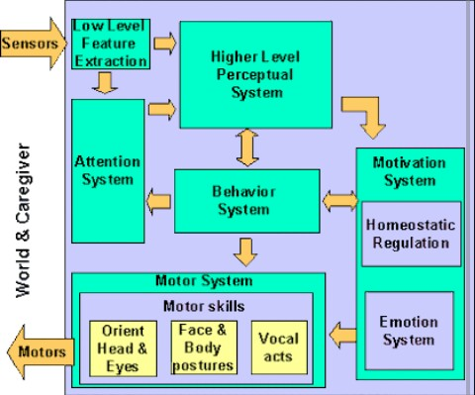
Attention:
83
Notes:
83

Slide 84


Brain basis of attention
Maintaining attention against distraction requires a significant effort;
E.g. trying to study amidst distractions
Thus mental effort comes from struggle between voluntary
and automatic attention.
84
Notes:
84

Slide 85
Attention(contd..)
The term attention :
the act or faculty of attending, especially directing the mind to an object .
a concentration of the mind on a single object or thought, especially one preferentially selected from a complex, with a view to limiting or clarifying receptivity by narrowing the range of stimuli .
a state of consciousness characterized by such concentration .

Slide 86
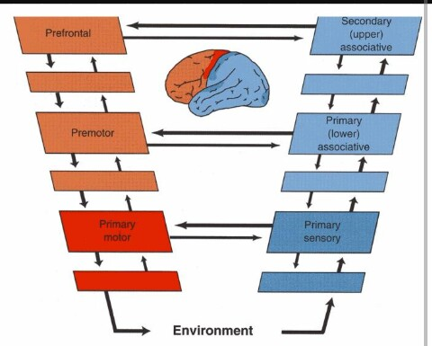
Sensory motors:

Slide 87
Sensory motors(contd..)
The neural basis of mental imagery has been investigated by localizing the underlying neural networks, mostly in motor and perceptual systems, separately.*
Imagined speech production (“articulation imagery”), which induces the kinesthetic feeling of articulator movement and its auditory consequences, provides a new angle because of the concurrent involvement of motor and perceptual systems.
Notes:
*However, how modality-specific representations are top-down induced and how the action and perception systems interact in the context of mental imagery is not well understood.

Slide 88
Sensory motors(contd..)
On the basis of previous findings in mental imagery of speech, we argue for the following regarding the induction mechanisms of mental imagery and the interaction between motor and perceptual systems: (1) Two distinct top-down mechanisms, memory retrieval and motor simulation, exist to induce estimation in perceptual systems. (2) Motor simulation is sufficient to internally induce the representation of perceptual changes

Slide 89
Summary of computational modEL.
A machine is conscious if besides the required components for perception, action, and associative memory, it has a central executive that controls all the processes (*) of the machine.
The central executive is driven by the machine’s motivation and goal selection, attention switching, learning mechanism, etc. and uses cognitive perception and cognitive understanding of motivations, thoughts, or plans.
Notes:
*conscious or subconscious

Slide 90
Summary of computational modEL.
Thus, central executive, by relating cognitive experience to internal motivations and plans, creates self-awareness and conscious state of mind.
According to us, there can be only one thought at any moment in the conscious state of a conscious machine.
According to us ,“Conscious machine central executive directs cognitive aspects of machine experiences but its operation is influenced by competing signals representing motivations, desires, and attention switching that are not necessarily cognitive or consciously realized.

Slide 91
Summary of computational modEL.
Instead, its decisions are the result of competition between signals that represent motivations, pains and desires. At any moment, competition between these signals can be interrupted by attention switching signal.
Such signals constantly vary in intensity as a result of internal stimuli (e.g., hunger) or externally presented and observed opportunities.
Thus, the fundamental mechanism that directs machine in its action is physically

Slide 92
Summary of computational modEL.
distributed as competing signals are generated in various parts of machine’s mind.
Further, it is not fully cognitive, since, before a winner is selected, machine does not interpret the meaning of competing signals”.
Hence, in our opinion, Rosenthal’s HOT theory is based on fallacy that multiple thoughts exist in conscious machine simultaneously.

Slide 93

Conclusion
Consciousness is a property of a
physical mind not a meta-physical phenomenon.
Consciousness is a physical phenomenon which can be realized in machines.
This field of consciousness is still in its infancy, it is becoming respectable, with growing interest in its results.
As machine consciousness matures it is also starting to raise some novel social and ethical issues.

Slide 94

FuturE SCOPE:
*The five different approaches that have dominated work in artificial consciousness so far bring to mind nothing so much as the parable of the blind men and the elephant.
Notes:
1*Given the barriers to investigating artificial consciousness, it is not surprising that past work has been limited in a number of ways

Slide 95
FuturE SCOPE(contd..)
While the work done to date has been substantial, it has not adequately separated out the information processing (functional) aspects of consciousness from the phenomenal aspects that are associated with the ‘‘hard problem’’ of consciousness.
Further, while each of the five core properties underlying past computational models does seem to correlate with consciousness, each also seems to error on the side of being overly encompassing.
These things has to be overcome.

Slide 96

Any QUESTIONS?????

Slide 97


